Slide 1
Final Presentation
Forest Inventory/FMIS Dr. Robert Tennent
December 1st, 2009

Slide 2
Activities
Identify training needs
Conduct inventory training
Identify forest cover strata
Develop sampling design
Conduct sampling (Jan 09 to May 09)
Analyze results
Develop FMIS
Develop management plans

Slide 3
Field work

Slide 4
Field work
5 months work
Over 20 individuals involved
416 plots measure
12,636 trees measured
$35,000 per diem paid
17,500 km travelled

Slide 6
Results
540 trees per hectare
305 cubic metres per hectare
Overall accuracy 4.4%
Total volume 2.8 million cubic metres

Slide 7
Overall results

Slide 8
Volume by species, size

Slide 9
Analysis of growth
1982 overall average 187 cu. m.
2009 overall average 305 cu. m.
Average increment 4.4 cu. m. per year
1.8% annual increment

Slide 10
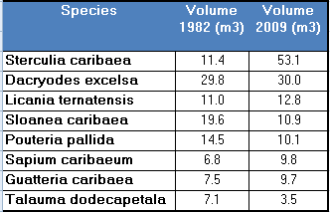
Specific changes

Slide 11
FMIS
PSP system
Forest structure
Inventory data entry
Inventory analysis
Forest management

Slide 12
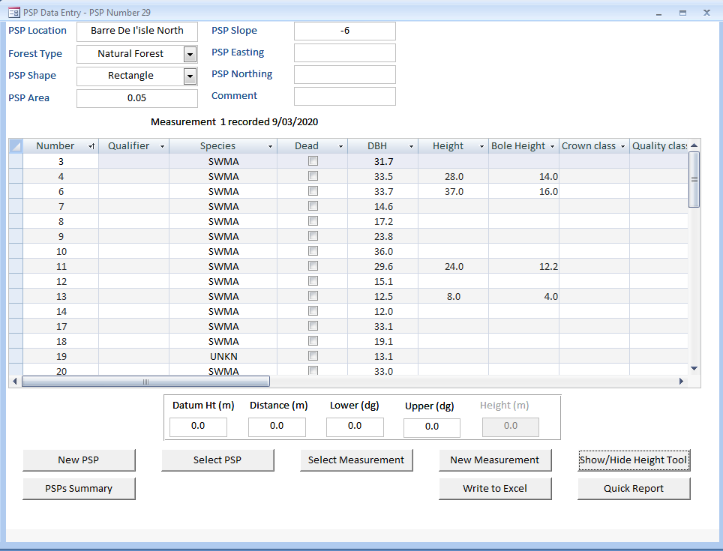

Slide 13
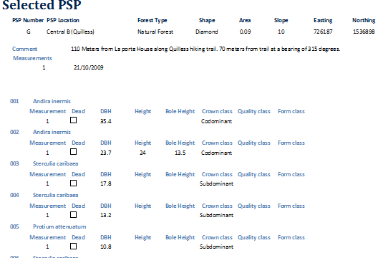

Slide 14
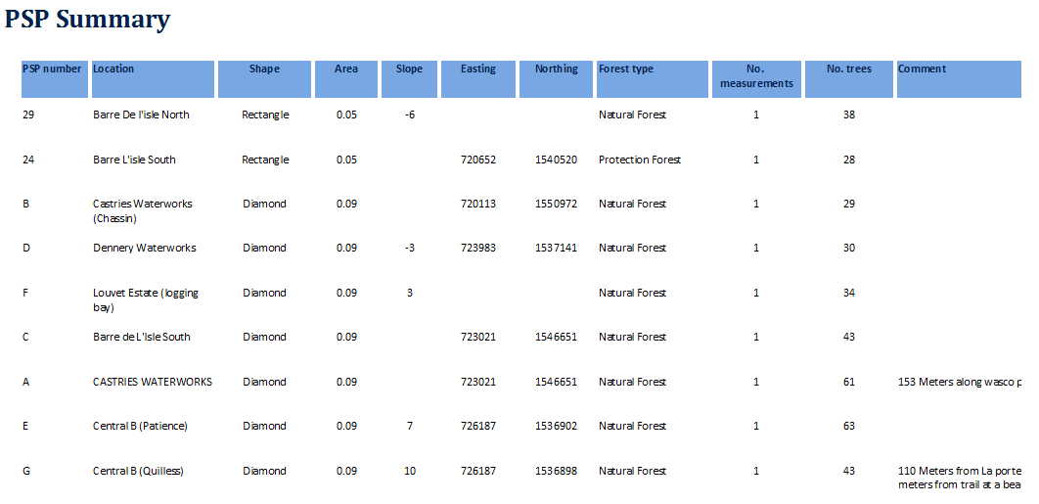

Slide 18
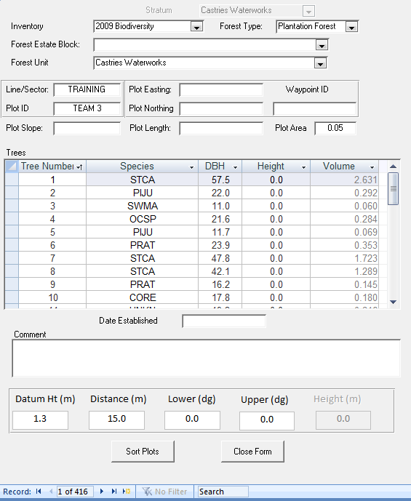

Slide 19
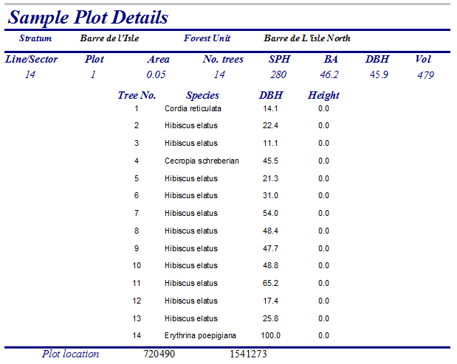

Slide 20
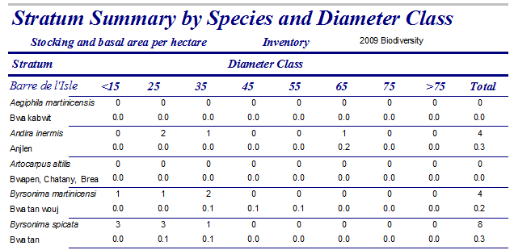

Slide 21
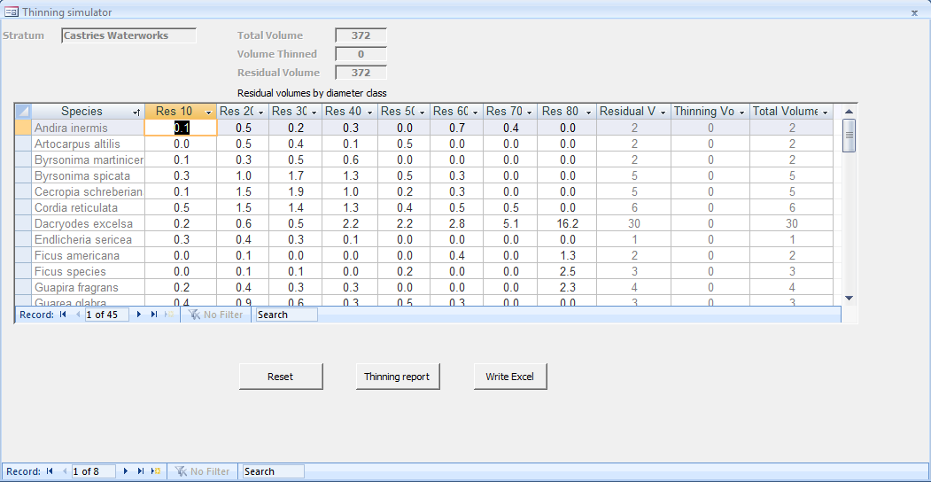

Slide 22
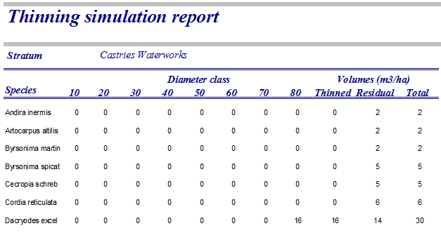

Slide 23
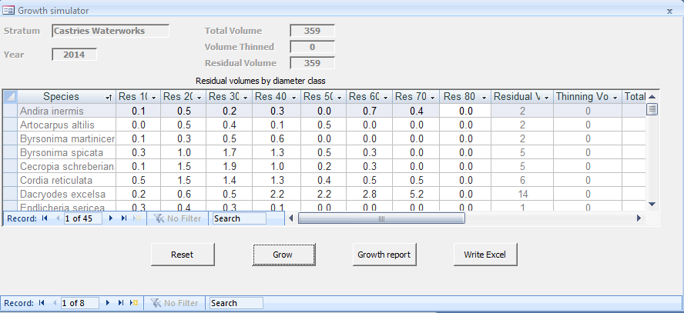

Slide 24
Thank you

